Slide 1
Weight and Mass

Slide 2
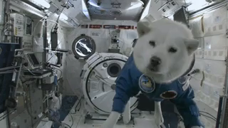
By the end of this lesson, you should be able to:
Explain the relationship between gravity, weight and mass.
Calculate weights on different planets.

Slide 3
Gravity, also known as gravitational force, is a non-contact force.
This means that it can act between objects that are not touching.

Slide 4
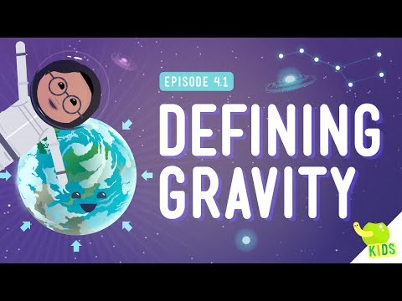

Slide 5
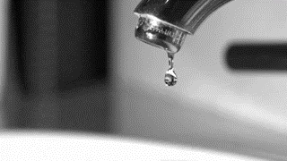
Gravity is only noticeable for really big masses, such as the Earth.
The Earth's gravity holds everything down to Earth, like building, trees and people.
Gravity pulls things toward the centre of the Earth. This is why you can be anywhere along the surface of the Earth and not fall off.

Slide 6
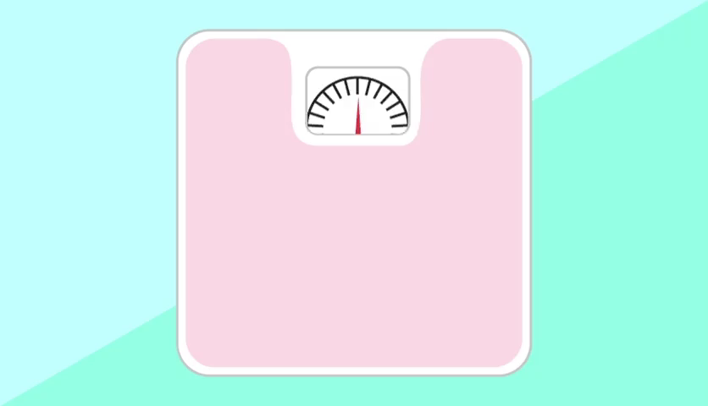
What is the difference between mass and weight?
In everyday life, the terms mass and weight are interchangeable. However, in physics they have special meanings.
Mass is the amount of matter in an object, measured in kilograms (kg). Your mass is the same (constant) wherever you are, even if you go to a different planet!

Slide 7
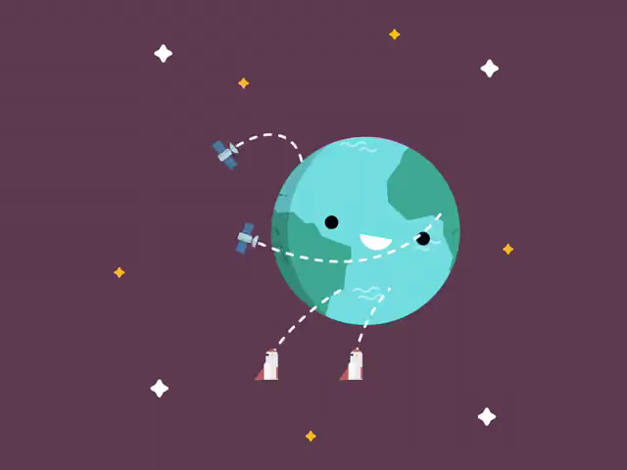
Weight is the force acting on an object due to gravity.
It is the gravitational force between an object and the planet it is sitting on.
It is a way of measuring the effect of gravity on objects on the surface of a planet.
Weight is measured in newtons, just like every other force.

Slide 8
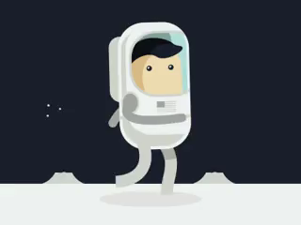
How does mass affect weight?
Your weight changes on planets with different gravity to Earth, however your mass is always the same, no matter where you are!
Two objects with different masses will have a different weight force on Earth.
An object with a greater mass will have a stronger weight force than an object with a smaller mass.

Slide 9
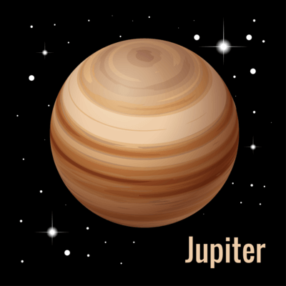
Example:
The gravitational force on Jupiter is 2.6 times larger than the gravitational force on Earth.
This means that if you go to Jupiter, you will weigh 2.6 times more than you do on Earth. However, your mass will still be the same!

Slide 10
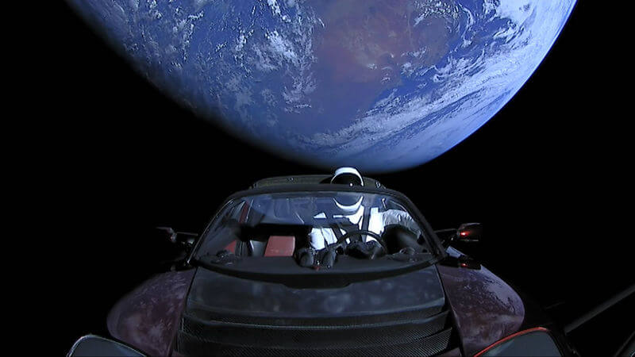
Let's look at another example:
In February 2018, Elon Musk of SpaceX sent a Tesla Roadster sports car into space. On Earth, this car weighs 1300 kg.
If this car was to somehow land on Mars still intact, how much would it weigh given that gravity on the planet is 38% as strong as Earth's?

Slide 11
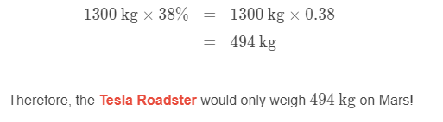
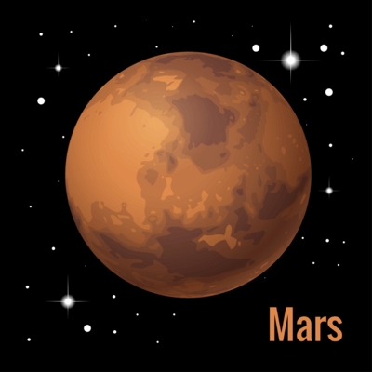
Solution:
The weight of an object is determined by the gravitational pull it experiences. Hence, the smaller the gravitational pull from a planet, the smaller the weight.
The gravity on Mars is 38% the strength of that on Earth. Therefore, we can multiply this by the weight of the car on Earth to find its weight on Mars:

